Slide 1

Department of Computer Science and Engineering CSA4001 –Management Information Systems for Data Optimization
University Admission and Enrollment Management System
Team Members Name : (192110526 & KISHORE KUMAR S)
Date of Submission: 20-03-2025

Slide 2
Abstract
Problem Statement: Managing student admissions and enrollments efficiently.
Purpose: Develop a system that automates student registration, course selection, and enrollment tracking.
Outcome: A structured MIS that streamlines admission processes, reduces manual errors, and provides real-time insights.

Slide 3
Table of Contents
Introduction
Problem Identification and Analysis Solution
Design and Implementation Results and Recommendations
Coding
Output Screenshots
Reflection on Learning and Personal Development
Conclusion
References

Slide 4
Introduction
• Background:
- Challenges in handling student admissions, course enrollments, and tracking applications.
- Traditional methods involve paperwork or spreadsheets, leading to inefficiencies.
• Objectives:
- Automate student registration and enrollment processes.
- Provide a structured database to manage student records.
- Ensure efficient and transparent admission procedures.

Slide 5
Problem Identification and Analysis
• Challenges:
- Manual admission processes lead to delays and inefficiencies.
- No centralized system to track student applications.
- Lack of automated notifications for admission deadlines.
• Supporting Data:
- 70% of institutions struggle with enrollment tracking.
- 40% of students face difficulties due to lack of clear application tracking.
• Key Stakeholders:
- University Administrators, Students, Academic Staff

Slide 6
Solution Design and Implementation
Frontend Technologies:
HTML – Structure of the web pages
CSS – Styling and layout
JavaScript – Interactivity and dynamic content
Backend & Deployment:
Firebase – Hosting, authentication, and database services
Development Tools:
Visual Studio Code (VS Code) – Code editor

Slide 7
Results and Recommendations
• Evaluation of Results:
- Improved efficiency in enrollment tracking.
- Automated reminders reduce application delays.
• Challenges Encountered:
- Managing large datasets efficiently.
- Ensuring seamless user experience.
• Future Improvements:
- Mobile app integration for accessibility.
- AI-based predictive analytics for admission forecasting.

Slide 8
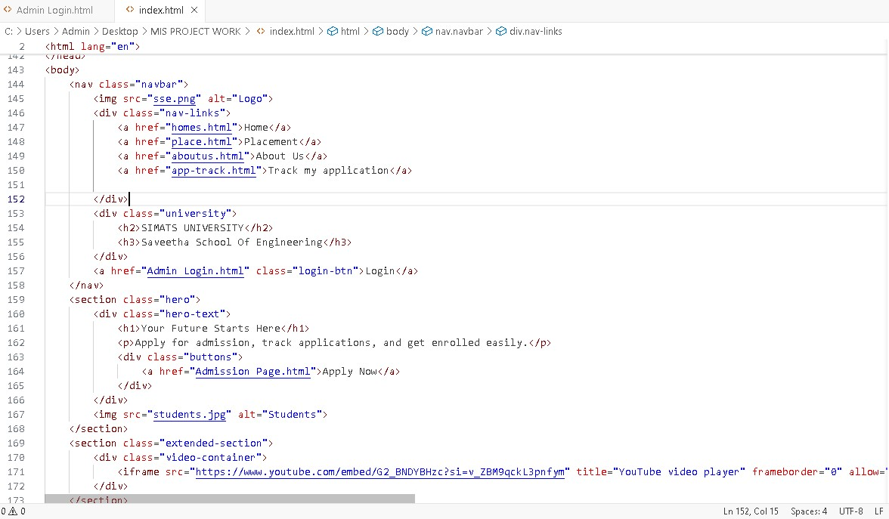
Coding

Slide 9
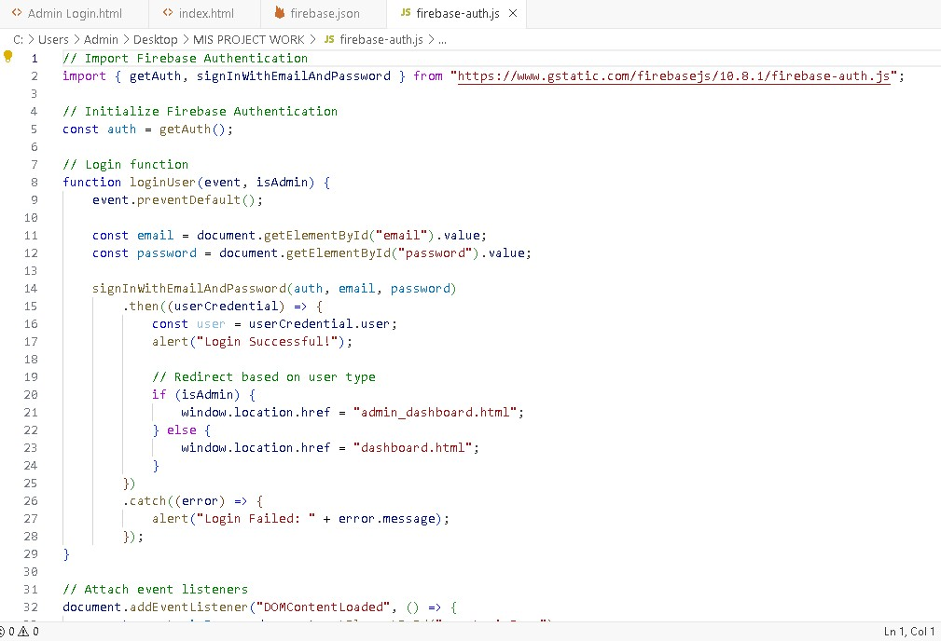
Coding

Slide 10
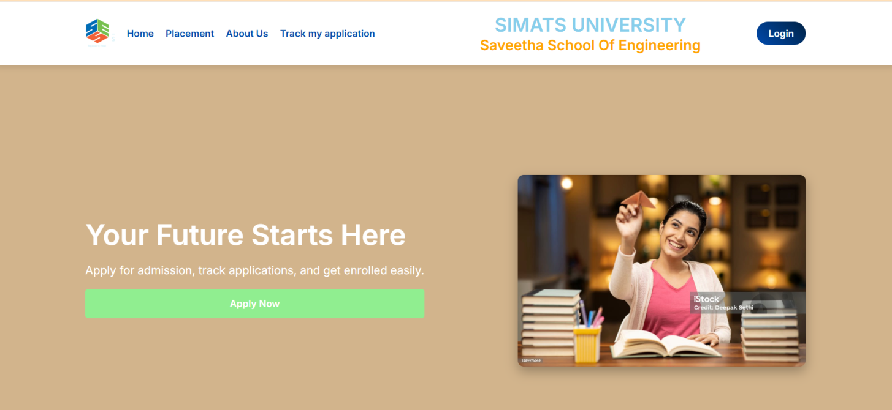
Output Screenshots

Slide 11
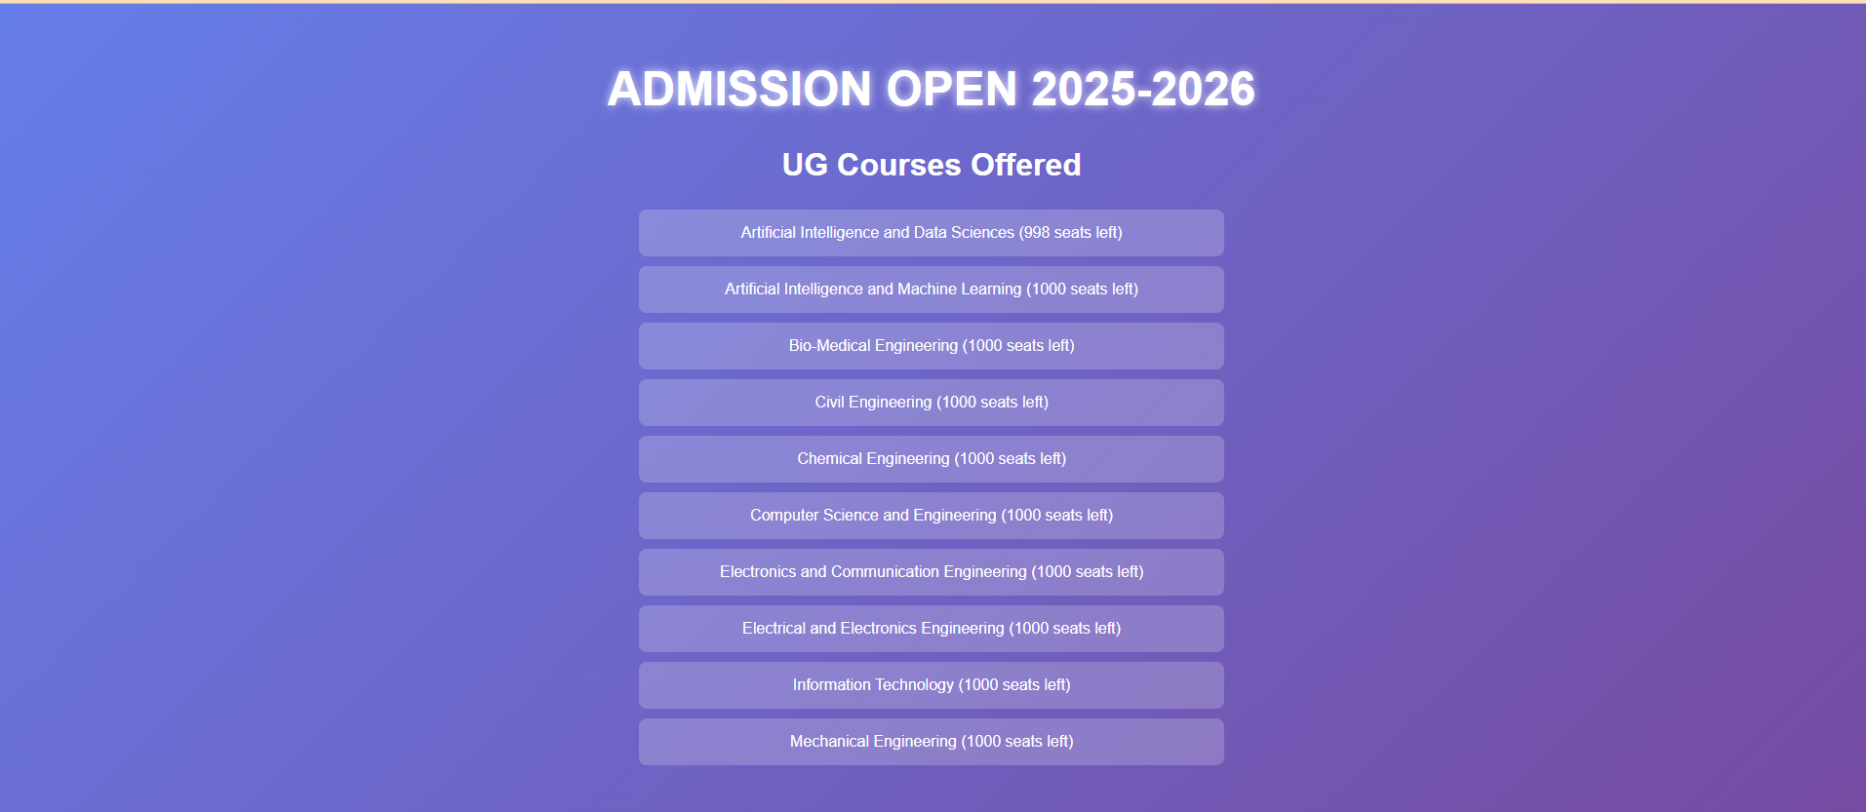
Output Screenshots

Slide 12
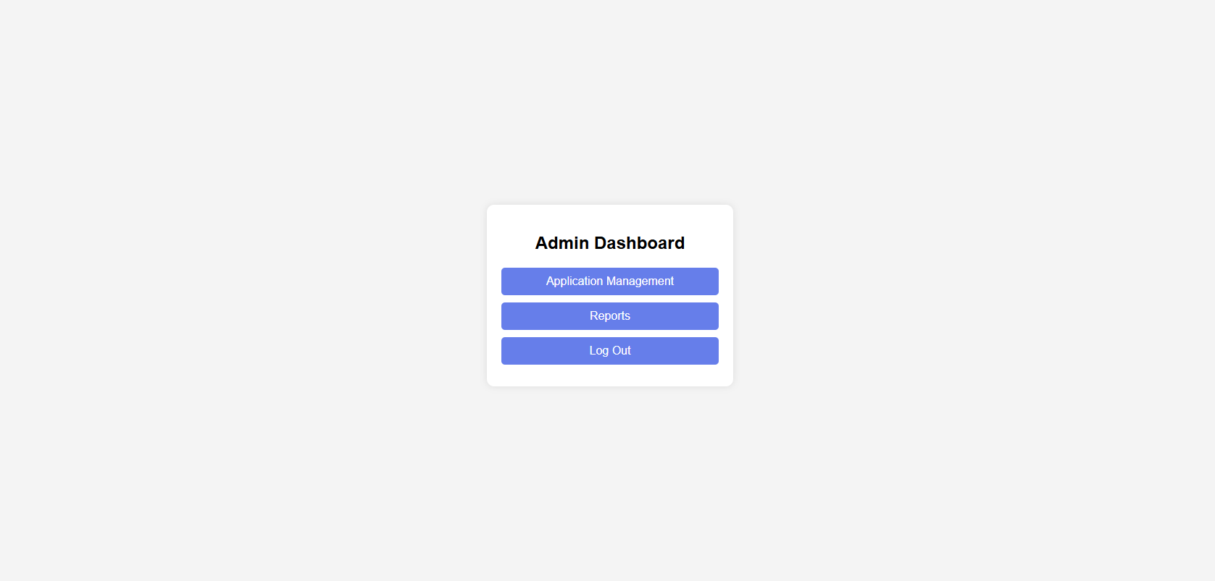
Output Screenshots

Slide 13
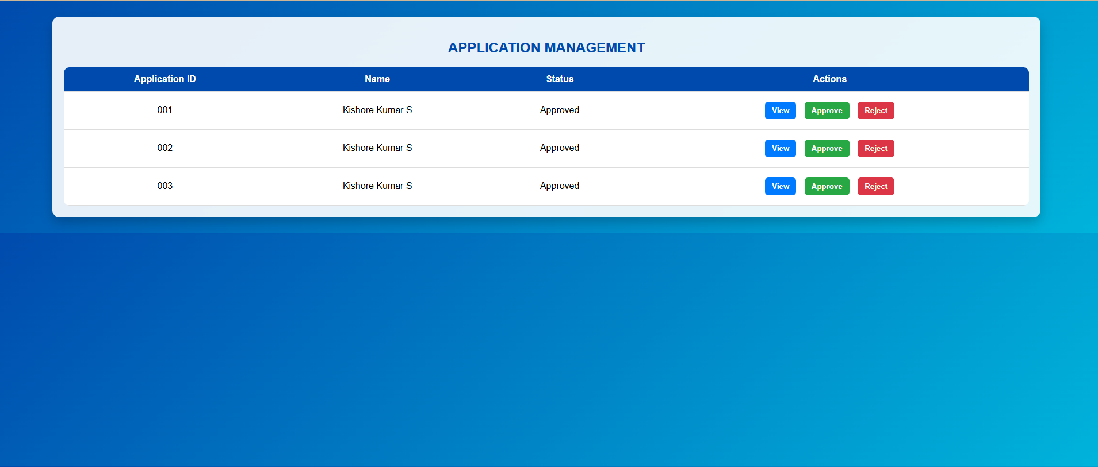
Output Screenshots

Slide 14
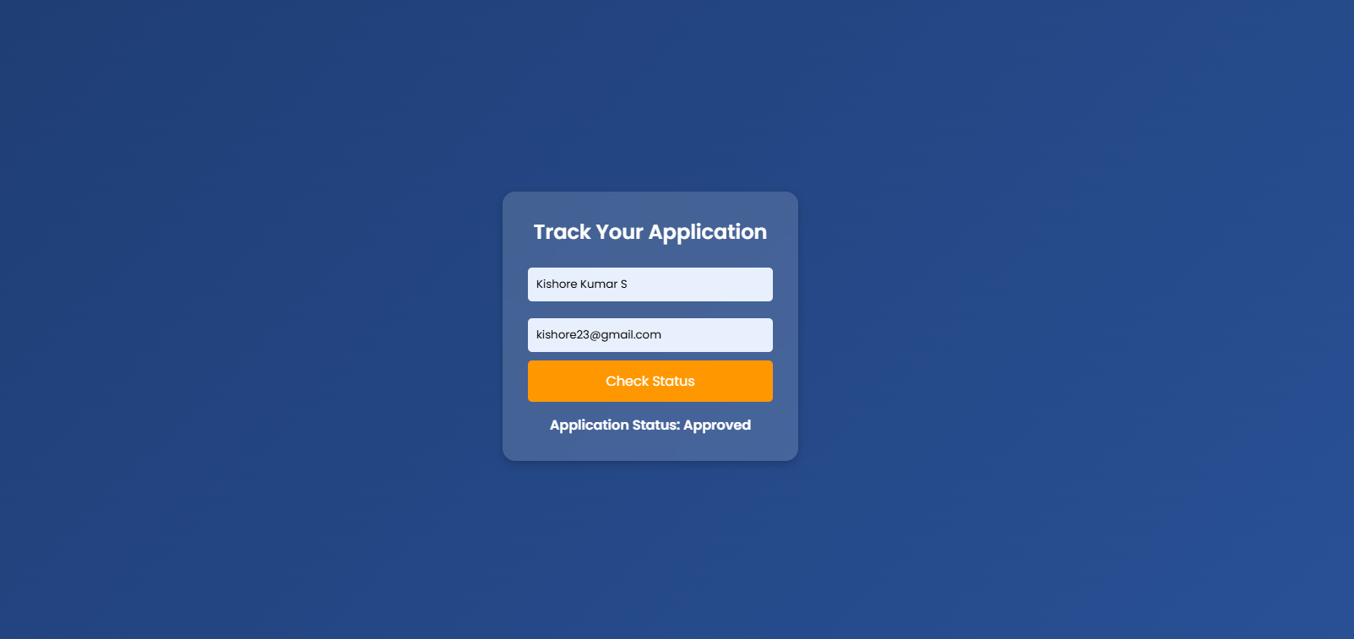
Output Screenshots

Slide 15
Reflection on Learning and Personal Development
• Key Learnings:
- Importance of database optimization.
- UI/UX considerations for user-friendly systems.
• Challenges Overcome:
- Handling large datasets efficiently.
- Ensuring seamless user experience.

Slide 16
Conclusion
• Findings:
- The system automates student enrollment, reducing manual errors.
- Real-time tracking improves admission transparency and efficiency.
• Future Scope:
- Mobile app integration for remote enrollment access.
- AI-based analytics for predicting student enrollment trends.
- Integration with cloud databases for scalability.

Slide 17
References
1. Laudon, K. C., & Laudon, J. P. (2020). Management Information Systems: Managing the Digital Firm (16th Edition). Pearson.
2. Turban, E., Pollard, C., & Wood, G. (2018). Information Technology for Management. Wiley.
3. Sharma, R., & Singh, R. (2021). Student Admission Systems: A Study on Digital Transformation in Higher Education. International Journal of Computer Applications.
4. Gupta, P., & Mehta, S. (2019). Automated Enrollment Systems: A Review on Digital Innovation in Education. IEEE Xplore.

